Slide 1

Sunny Hospital Database
Tatiana Frolova
CIS 2165
Sinclair Community College

Slide 2

Sunny Hospital Description
I have built a limited version of the hospital database.
Hospital database would be built for the healthcare population/medical staff, clinicians, providers, and anyone who works in the medical field.
How big the database all depends on how big the medical business is. Therefore, the Sunny hospital database would be a perfect match for small private practices or medical start-up offices that just start their own business;
There is possible to extend the current database and has the potential to grow and expand the database and records.
The Sunny Hospital will help to provide medical staff with reliable and needed information about patients in the house, Patient Primary contacts, and Physicians’ Information.

Slide 3
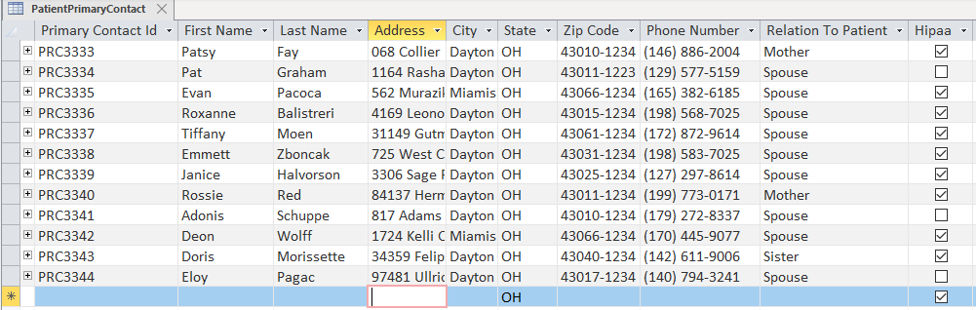
Patient Primary Contact Table

Slide 4
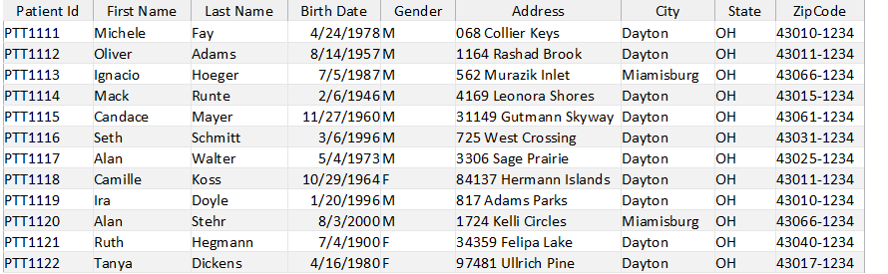
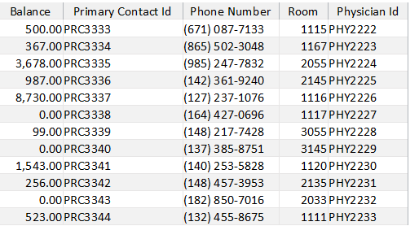
Patient Table

Slide 5
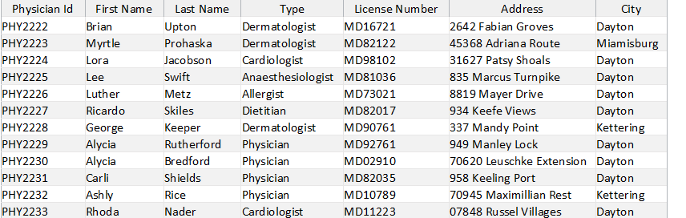
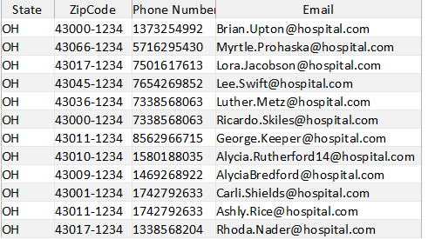
Physician Table

Slide 6
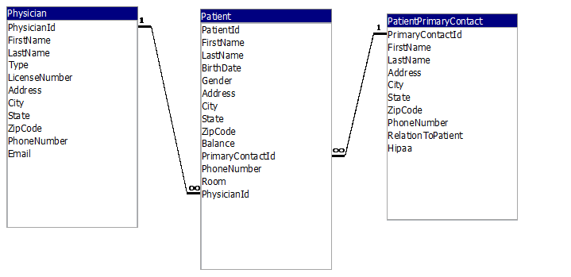
Fields Relationships(DBDL)

Slide 7
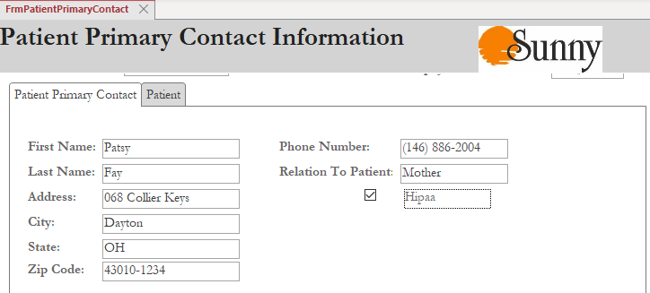
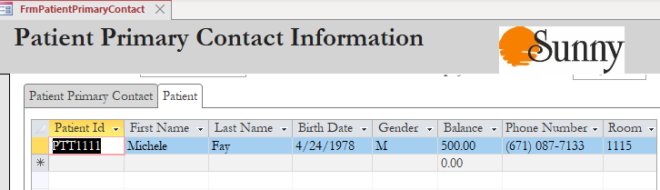
Patient Primary Contact Information Form with Patient Subform

Slide 8
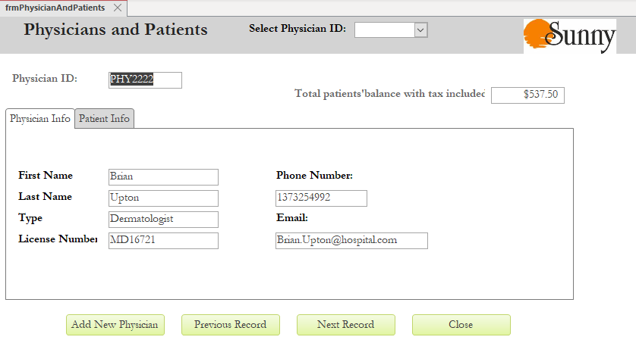
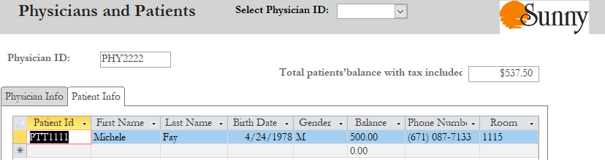
Physicians and Patients Form with Patient Info Subform

Slide 9
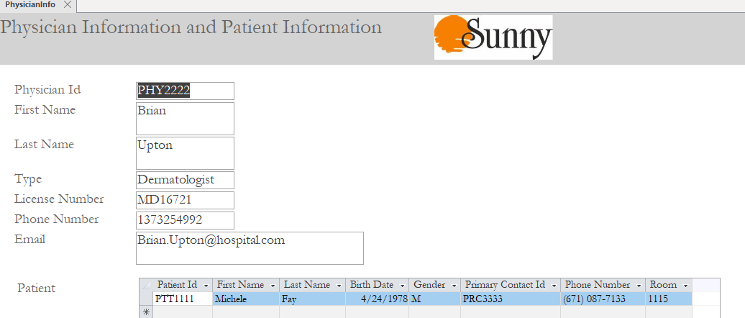
Physician and Patient Information Form

Slide 10
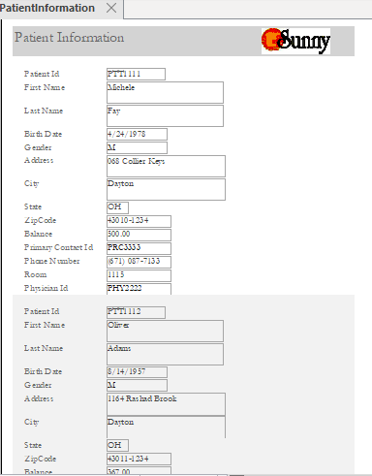
Patients Information Form

Slide 11
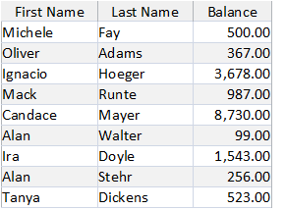
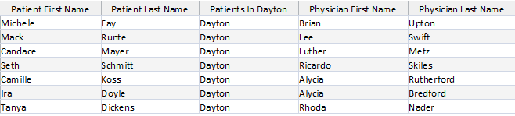
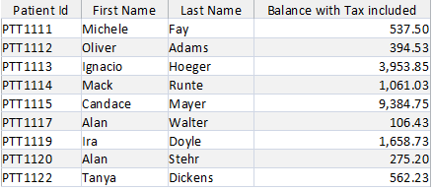

Queries
Patient Positive Balance query
Balance with Tax
Patients and Physicians in Dayton
Physicians In Kettering and Miamisburg

Slide 12
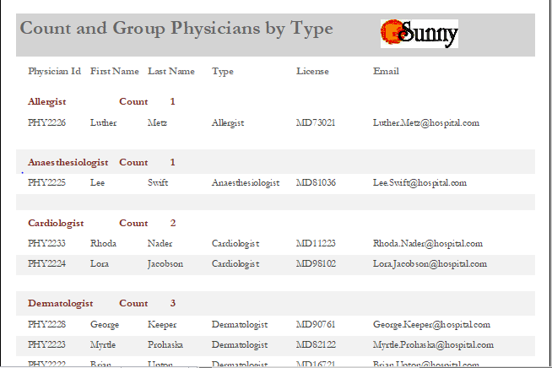
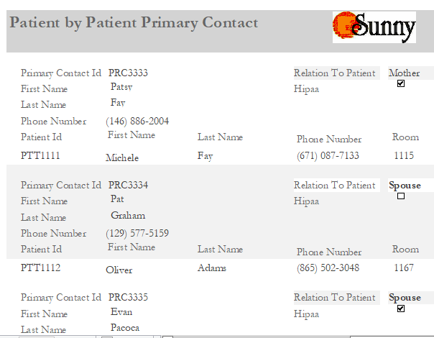
Reports
Count and Group Physicians By Type
Patients By Primary Contacts

Slide 13
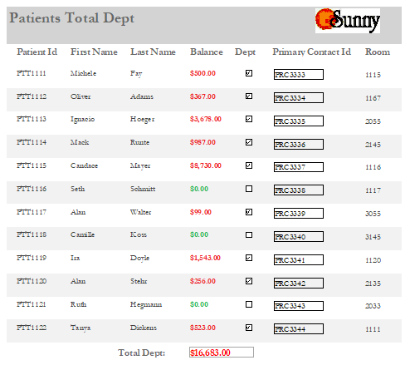
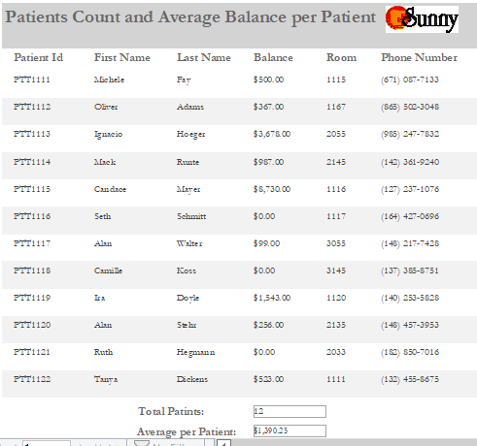
Reports
Patients Total Dept
Patients Count and Average Balance

Slide 14
Lessons Learned/What would do differently
I would make a database with more tables; therefore, I would have more room to build forms and reports
I would add to tables TIME/DATES fields included that would give more room to build more complex queries and reports.

Slide 15
Summary of learning this term
Learned how to use Microsoft Access
Database design
This term I have learned about traditional database concepts such as normalization, and table relationships.
Learned about the relational model, Query-By-Example(QBE), and SQL

Slide 16
Thank you for the course!

